Slide 1
Linear Algebra
HW1 Cycle Detection
袁培傑

Slide 2
Outline
Task Introduction
Problem 1
Problem 2
Python Tips
Rules

Slide 3
Task Introduction

Slide 4
Graph
A graph contains some nodes and edges
The edges can be directed or undirected
This task is given the directed graph, we need to find out whether there is a cycle in the graph
1
6
1
6
4
4
0
2
0
2
5
5
3
7
3
7
Directed Graph
Undirected Graph

Slide 5
Directed Graph
0 → 1
0 → 3
1 → 2
1 → 4
2 → 3
2 → 5
4 → 6
5 → 4
6 → 7
7 → 5
1
6
4
0
2
5
3
7

Slide 6
Cycle Detection
0 → 1
0 → 3
1 → 2
1 → 4
2 → 3
2 → 5
4 → 6
5 → 4
6 → 7
7 → 5
1
6
4
0
2
5
3
7

Slide 7
Problem 1

Slide 8
Graph Representation
 | 0 | 1 | 2 | 3 | 4 | 5 | 6 | 7
0 | -1 | 1
1 | -1 |  |  | 1
2 |  | -1 | 1
3 |  | -1 |  |  | 1
4 |  |  | -1 | 1
5 |  |  | -1 |  |  | 1
6 |  |  |  |  | -1 |  | 1
7 |  |  |  |  | 1 | -1
8 |  |  |  |  |  |  | -1 | 1
9 |  |  |  |  |  | 1 |  | -1
A row is a connection
If a connection is from 0 to 1, the value of column 0 will be -1 and the value of column 1 will be 1
0 otherwise
0 → 1
0 → 3
1 → 2
1 → 4
2 → 3
2 → 5
4 → 6
5 → 4
6 → 7
7 → 5

Slide 9
Linear Dependent
Linear independence in row
2 | 1 | 3
1 | -1 | 4
-2 | 5 | 1
1 | 1 | -2
2 | 1 | 3
0 | 3 | -5
0 | 6 | 4
0 | -1 | 7
2 | 1 | 3
0 | 3 | -5
0 | 0 | -7
0 | 0 | 16
✕ -2
✕ 1
✕ -1/2
✕ -2
✕ 3
In cycle detection, we can only do ADDITION

Slide 10
Linear Dependent to Detect Cycle
2 → 1
1 → 0
0 → 2
1 → 3
0 | 1 | -1 | 0
1 | -1 | 0 | 0
-1 | 0 | 1 | 0
0 | -1 | 0 | 1
1 | -1 | 0 | 0
-1 | 0 | 1 | 0
0 | -1 | 0 | 1
1 | 0 | -1 | 0
0 | 0 | -1 | 1
0 → 2
2 → 0
-1 | 0 | 1 | 0
0 | -1 | 0 | 1
1 | 0 | -1 | 0
0 | 0 | -1 | 1
0 | -1 | 1 | 0
2 → 0
2 → 3
1
1
1
1
0
2
3
0
2
3
0
2
3
0
2
3

Slide 11
Termination
If we get a ALL 0 row after addition, then the graph has a cycle.
If we do addition on all the edges and we don’t get a ALL 0, then the graph does not have a cycle.

Slide 12
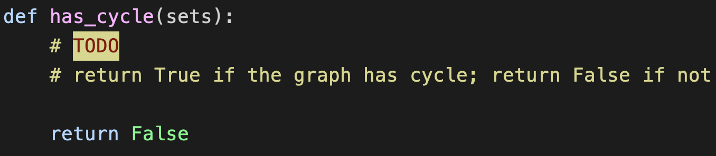
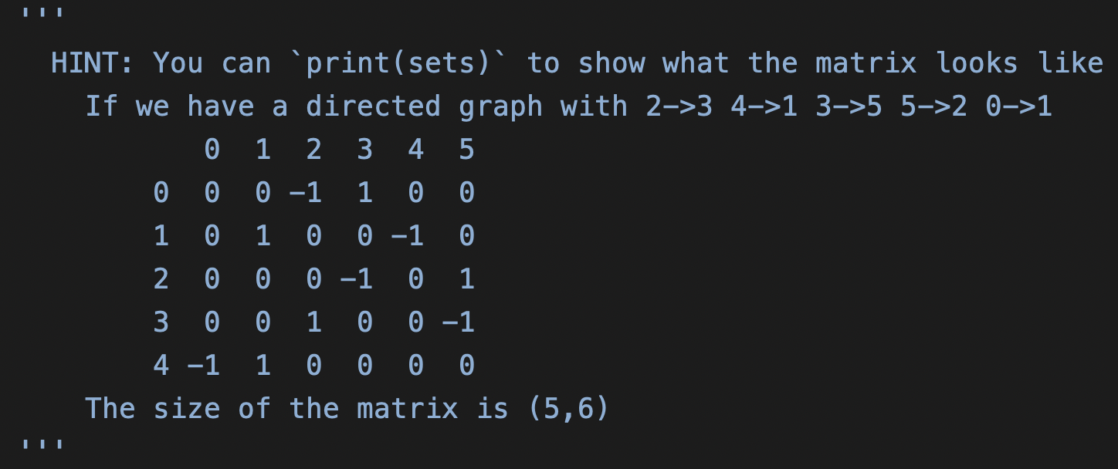
p1.py

Slide 13
Problem 2

Slide 14
Graph Representation
 | 0 | 1 | 2 | 3 | 4 | 5 | 6 | 7
0 |  | 1 |  | 1
1 |  |  | 1 |  | 1
2 |  |  |  | 1 |  | 1
3
4 |  |  |  |  |  |  | 1
5 |  |  |  |  | 1
6 |  |  |  |  |  |  |  | 1
7 |  |  |  |  |  | 1
A cell(x,y) = 1 if there is a connection from x to y
0 otherwise
0 → 1
0 → 3
1 → 2
1 → 4
2 → 3
2 → 5
4 → 6
5 → 4
6 → 7
7 → 5

Slide 15
Matrix Multiplication
0 | 0 | 1 | 0
1 | 0 | 0 | 0
0 | 1 | 0 | 0
0 | 1 | 0 | 0
0 | 0 | 1 | 0
1 | 0 | 0 | 0
0 | 1 | 0 | 0
0 | 1 | 0 | 0
0 | 1 | 0 | 0
0 | 0 | 1 | 0
1 | 0 | 0 | 0
1 | 0 | 0 | 0
1 → 0
×
=
2 → 0
2 → 1
Do multiplication at most N times. (N: # of nodes)

Slide 16
Matrix Multiplication
0 → 2
1 → 0
2 → 1
3 → 1
0 | 0 | 1 | 0
1 | 0 | 0 | 0
0 | 1 | 0 | 0
0 | 1 | 0 | 0
0 → 1
1 → 2
2 → 0
3 → 0
0 | 1 | 0 | 0
0 | 0 | 1 | 0
1 | 0 | 0 | 0
1 | 0 | 0 | 0
0 → 0
1 → 1
2 → 2
3 → 2
1 | 0 | 0 | 0
0 | 1 | 0 | 0
0 | 0 | 1 | 0
0 | 0 | 1 | 0
1
1
1
0
2
3
0
2
3
0
2
3

Slide 17
Termination
If we find a value bigger than 1 in the diagonal of matrix, then the graph has a cycle.
If we do N times of multiplication and all value in the diagonal are 0, then the graph does not have a cycle.

Slide 18
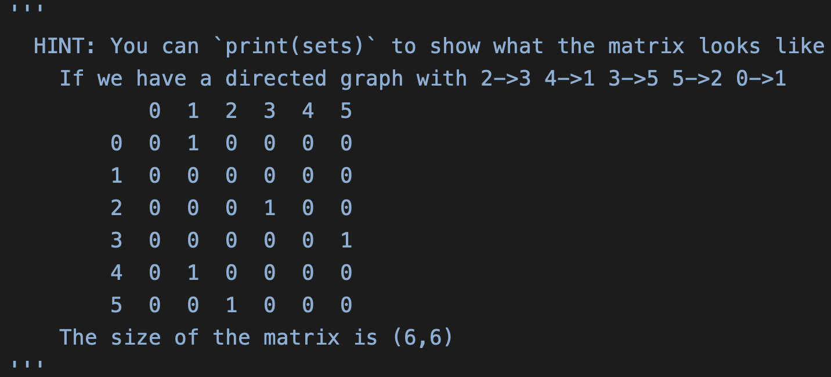
p2.py

Slide 19
Code Implementation
You should only complete the function `has_graph(sets)` in p1.py and p2.py. DO NOT modify the other parts of code
This function will return True or False
If the graph(sets) has cycles, this function should return True
Otherwise, return False

Slide 20
Python Tips

Slide 21
List
Generate an empty list
L = list() or L = []
Get a sublist of a list L
From A to B: L[A:B]
From begin to B: L[:B]
From A to end: L[A:]
Push an object in list
L.append(object)
L = [ 2, 4, [1, 2], [3, 6] ]
object = 8
L.append(object)
>>> L = [ 2, 4, [1, 2], [3, 6], 8 ]
Extend a list L2 and push it in list L
L.extend(L2)
L2 = [ 4, [2, 3] ]
L.append(L2)
>>> L = [ 2, 4, [1, 2], [3, 6], 8, 4, [2, 3] ]
0 | 1 | 2 | 3 | 4 | 5 | 6 | 7 | 8 | 9
0 | 1 | 2 | 3 | 4 | 5 | 6 | 7 | 8 | 9 | 10

Slide 22
NumPy
Create a numpy object
L = numpy.array( [ 3, 2, 5, 1 ] )
Two numpy matrix A, B multiplication
numpy.matmul(A, B)
A = [ [1, 2], [3, 4] ]
B = [ [2, 3], [4, 5] ]
numpy.matmul(A, B)
>>> [ [10, 13], [22, 29] ]

Slide 23
Rules

Slide 24
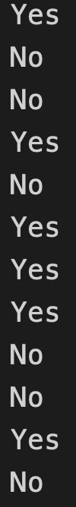
Run Code
python p1.py r07922072
Yes
No
No
… 12 outputs
You should run your code with your 學號
You can generate answer text file by running command python p1.py 自己的學號 > p1_ans.txt python p2.py 自己的學號 > p2_ans.txt
Or just type them by yourself

Slide 25
Code Structure
Code you download
|—p1.py ( TODO )
|—p2.py ( TODO )
|—graph_gen.py
Code you submit should be put in a folder and compressed in a zip file
r07922072_hw1.zip
r07922072_hw1
|—p1.py
|—p2.py
|—graph_gen.py
|—p1_ans.txt
|—p2_ans.txt

Slide 26
Rules
不要抄作業，不要交別人的答案，作弊一律0分計算
上傳 zip 檔案到 CEIBA
注意繳交的資料夾學號開頭英文用小寫
DEADLINE: 2018/10/18(四) 23:59 (GMT+8:00)
遲交每過一天：分數×0.8 (per day)
格式、檔案、各種奇怪的錯誤讓我無法改作業：分數×0.8

Slide 27
Q & A
ask on Facebook

